Slide 1

A Comparative Study of Catastrophic Forgetting in Neural Networks Continual Learning
Zeroth Review
Course Code: CS7510
Course Title: Project 2
24MSP3038
Aniket Shinde
20/02/2025

Slide 2
Problem Statement
Neural networks suffer from catastrophic forgetting, where learning new tasks leads to the loss of previously acquired knowledge. This project aims to compare different techniques for mitigating catastrophic forgetting, including Regularization-Based Methods such as Elastic Weight Consolidation (EWC) and Synaptic Intelligence (SI), Replay-Based Methods like Experience Replay, and Task-Specific Methods such as XDg (eXperts-Dedicated gating). The effectiveness of these approaches will be evaluated on the Split-MNIST dataset.

Slide 3
Dataset
Source of the Dataset: Yann LeCun, Corinna Cortes, Christopher J.C. Burges. "The MNIST Database of handwritten digits". http://yann.lecun.com/exdb/mnist/
No. of Observations: Training Samples: 60,000
Test Samples: 10,000
Column/Feature Details: Input Shape: (1, 28, 28)
No. of Classes: 10 (0-9 digits)
Screenshot of the dataset:

Slide 4
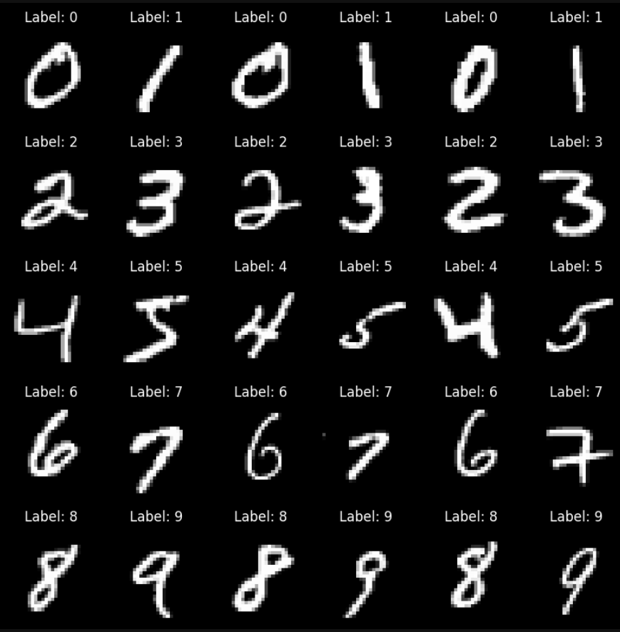
Dataset
Screenshot of the dataset:

Slide 5
Review of Related Literature
Base Paper:
Van de Ven, G. M., & Tolias, A. S. (2019). Three scenarios for continual learning. arXiv preprint arXiv:1904.07734. https://doi.org/10.48550/arXiv.1904.07734
Link to Paper
Paper I:
Wang, L., Zhang, X., Su, H., & Zhu, J. (2024). A comprehensive survey of continual learning: Theory, method and application. IEEE Transactions on Pattern Analysis and Machine Intelligence, 46(8), 5362-5383. https://doi.org/10.1109/TPAMI.2024.3367329
Link to Paper
Paper II:
De Lange, M., Aljundi, R., Masana, M., Parisot, S., Jia, X., Leonardis, A., Slabaugh, G., & Tuytelaars, T. (2022). A continual learning survey: Defying forgetting in classification tasks. IEEE Transactions on Pattern Analysis and Machine Intelligence, 44(7), 3366-3385. https://doi.org/10.1109/TPAMI.2021.3057446
Link to Paper
Paper III:
Lee, C. S., & Lee, A. Y. (2020). Clinical applications of continual learning machine learning. The Lancet Digital Health, 2(6), e279-e281. https://doi.org/10.1016/S2589-7500(20)30102-3
Link to Paper
Paper IV:
Chen, P. H., Wei, W., Hsieh, C.-j., & Dai, B. (2021). Overcoming catastrophic forgetting by generative regularization. arXiv preprint arXiv:1912.01238. https://doi.org/10.48550/arXiv.1912.01238
Link to Paper

Slide 6
Impact of the Proposed Research
This study will provide a comparative analysis of different catastrophic forgetting mitigation techniques, helping to identify their strengths, weaknesses, and trade-offs. The findings will contribute to better model selection for continual learning applications, improving the reliability of neural networks in real-world scenarios such as lifelong learning AI, autonomous systems, and evolving user preferences in recommender systems.

